Slide 1
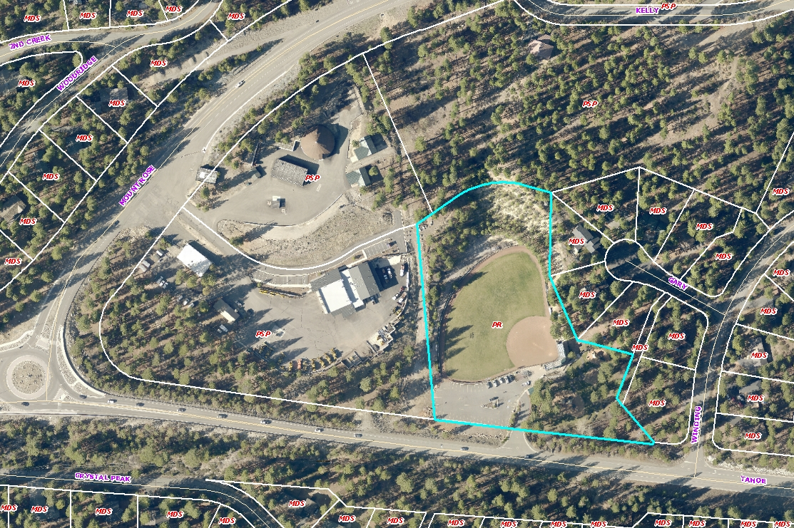
WADMIN18-0002
Incline Fine Arts Festival
Friday, August 10 to Sunday August 12, 2018
700 Tahoe Boulevard
Preston Field

Slide 2
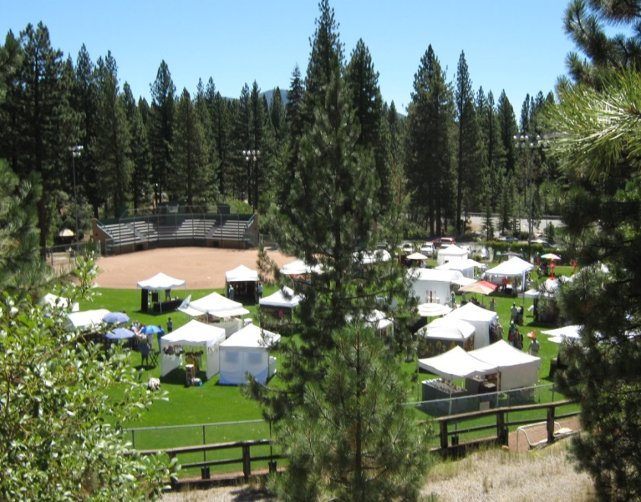
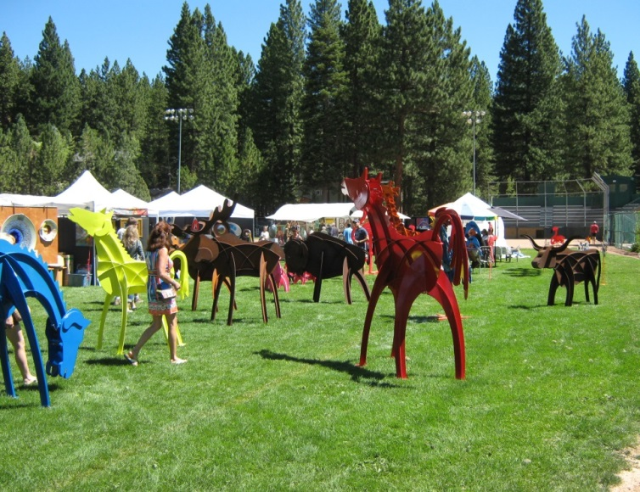
WADMIN18-0002
Fifth year of event
22+ vendors
Approximately 500 people per day
No amplified sound
No lighting
2014 Incline Arts Festival at Preston Field

Slide 3
WADMIN18-0002
Parking and Traffic Plan
NDOT permits
Attendance counts

Slide 4
WADMIN18-0002
I move that after giving reasoned consideration to the information contained in the staff report, information received during the public hearing, and subject to the conditions contained as Attachment A in the staff report, the Board of Adjustment approve WADMIN18-0002 for the Incline Village Fine Art Festival, having made all four findings in accordance with Washoe County Development Code Section 110.808.25:
1. Consistency
Improvements
Site Suitability
Issuance Not Detrimental

